Slide 1

Distance Education:
Issues and Trends
Edel 536
Richard Styner Eddie Lavrov Maria Morales
http://wow-achievements.com/wp-content/uploads/2012/05/learing.jpg

Slide 2

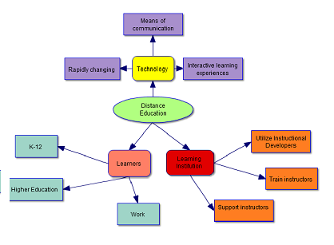
What is distance education?
According to MacTeer (2011), distance education means, “ or distance learning, is a field of education that focuses on the pedagogy, technology, and instructional system designs that aim to deliver education to students who are not physically “on site” in a traditional classroom or campus ” (p. i).

Slide 3


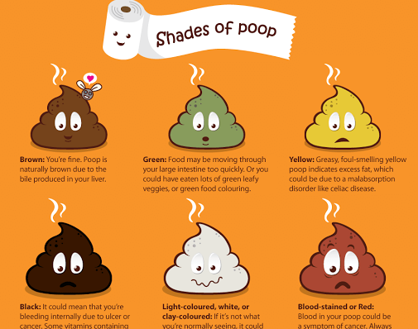
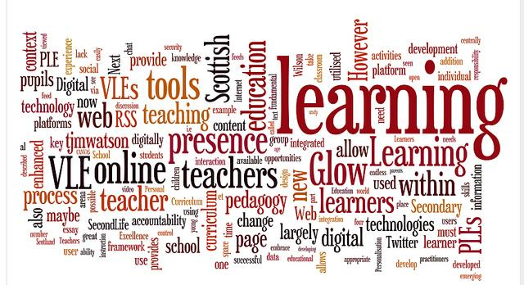
characteristics
?
Group work activities to facilitate social interaction such as group projects and discussion boards
Learning materials use visual representations such as tables, graphs, and pictures
Activities are designed to encourage interactivity
Plans in place to address technical problems with multiple ways to communicate with the instructor

Slide 4
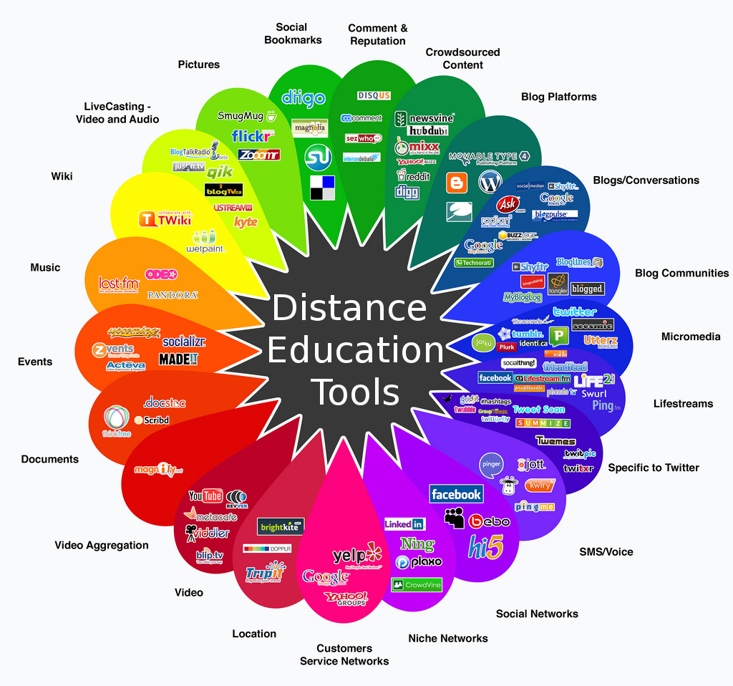
http://detools.wikispaces.com/file/view/detools.jpg/149759897/detools.jpg

Slide 5
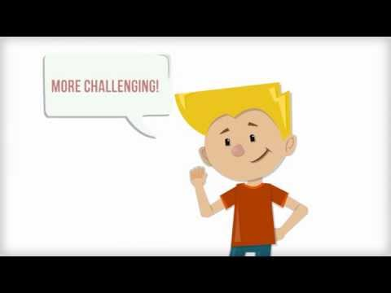
misconceptions
X
Online classes are easier.
Online classes take less time.
Work entirely at your own pace.
You won’t get to know other students.
You won’t get attention from the teacher.
You won’t learn as much online.
Online degrees don’t carry the respect of “traditional” degrees.
https://youtu.be/3K_JoBkxVI0

Slide 6

Issues
!
According to Beldarrain, when conducting a distance learning experience as a teacher/professor:
Need to give constant feedback
Familiarity with technology and online tools
Rethink pedagogical practices and instructional design
Provide flexible learning opportunities for ALL learners
Think how to present information
Teachers need to keep lessons, activities, and links up to date

Slide 7

Issues
!
According to the International Association of Distance Learning, when conducting a distance learning experience as the student:
Lack of interaction
Poor student mentorship
Lack of motivation
Inability to promote motor skill development
Inefficient in promoting good attitudes
Absent student - teacher bonding
Failure in developing oral skills
Inefficient feedback system
Not having the updated system

Slide 8
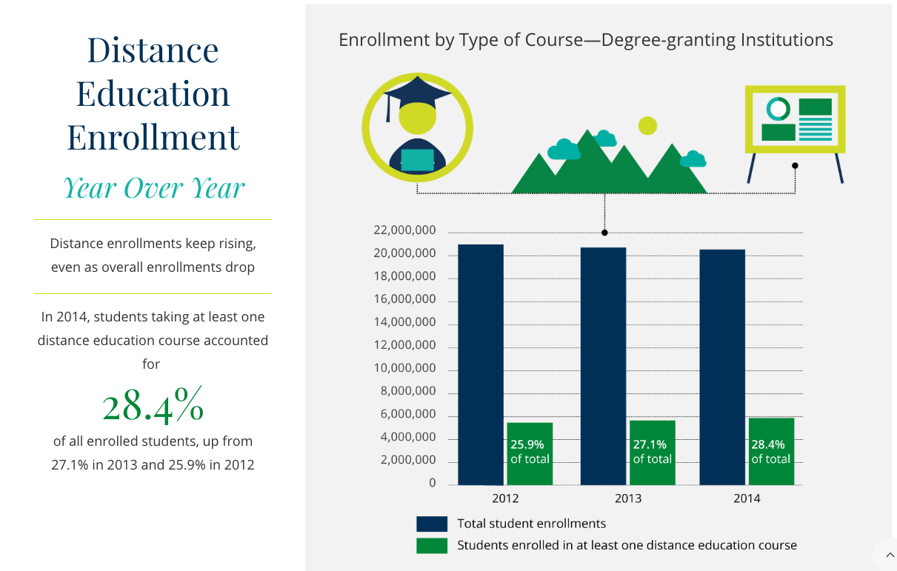
Trends
Enrollment in Distance Education increasing despite decline in overall enrollment
Personalized Learning
Gamification
Mobile Learning - using mobile devices and apps
Pearson (2016), http://www.pearsoned.com/higher-education/online-report-card-2016
Reference: Radwan (2014)
Notes:
Trends in DE
Enrollment in Distance Education is increasing slowly but steadily. There may be many factors contributing to this trend such as demand from students or staff, encouraged by the school administration as strategic necessity, or the general wider acceptance of Distance Education as method of learning.
Advances in learning management systems enable ways to increase student engagement such as:
Personalized Learning allows students to customize their learning environment and allows students to choose their preferred tools for learning and creating assignment artifacts.
Gamification adds a layer over the learning system that awards students experience points for completing tasks. Accumulating points can lead to badges or recognition for reaching a specific level, completing a certain task, or sequence of tasks. This adds to engagement by giving students instant feedback. It can also be an alternate way of tracking progress.
Some learning systems have mobile apps that allow you to interact with the content on a mobile device. Assignments could also be completed with a mobile device's camera or microphone.

Slide 9
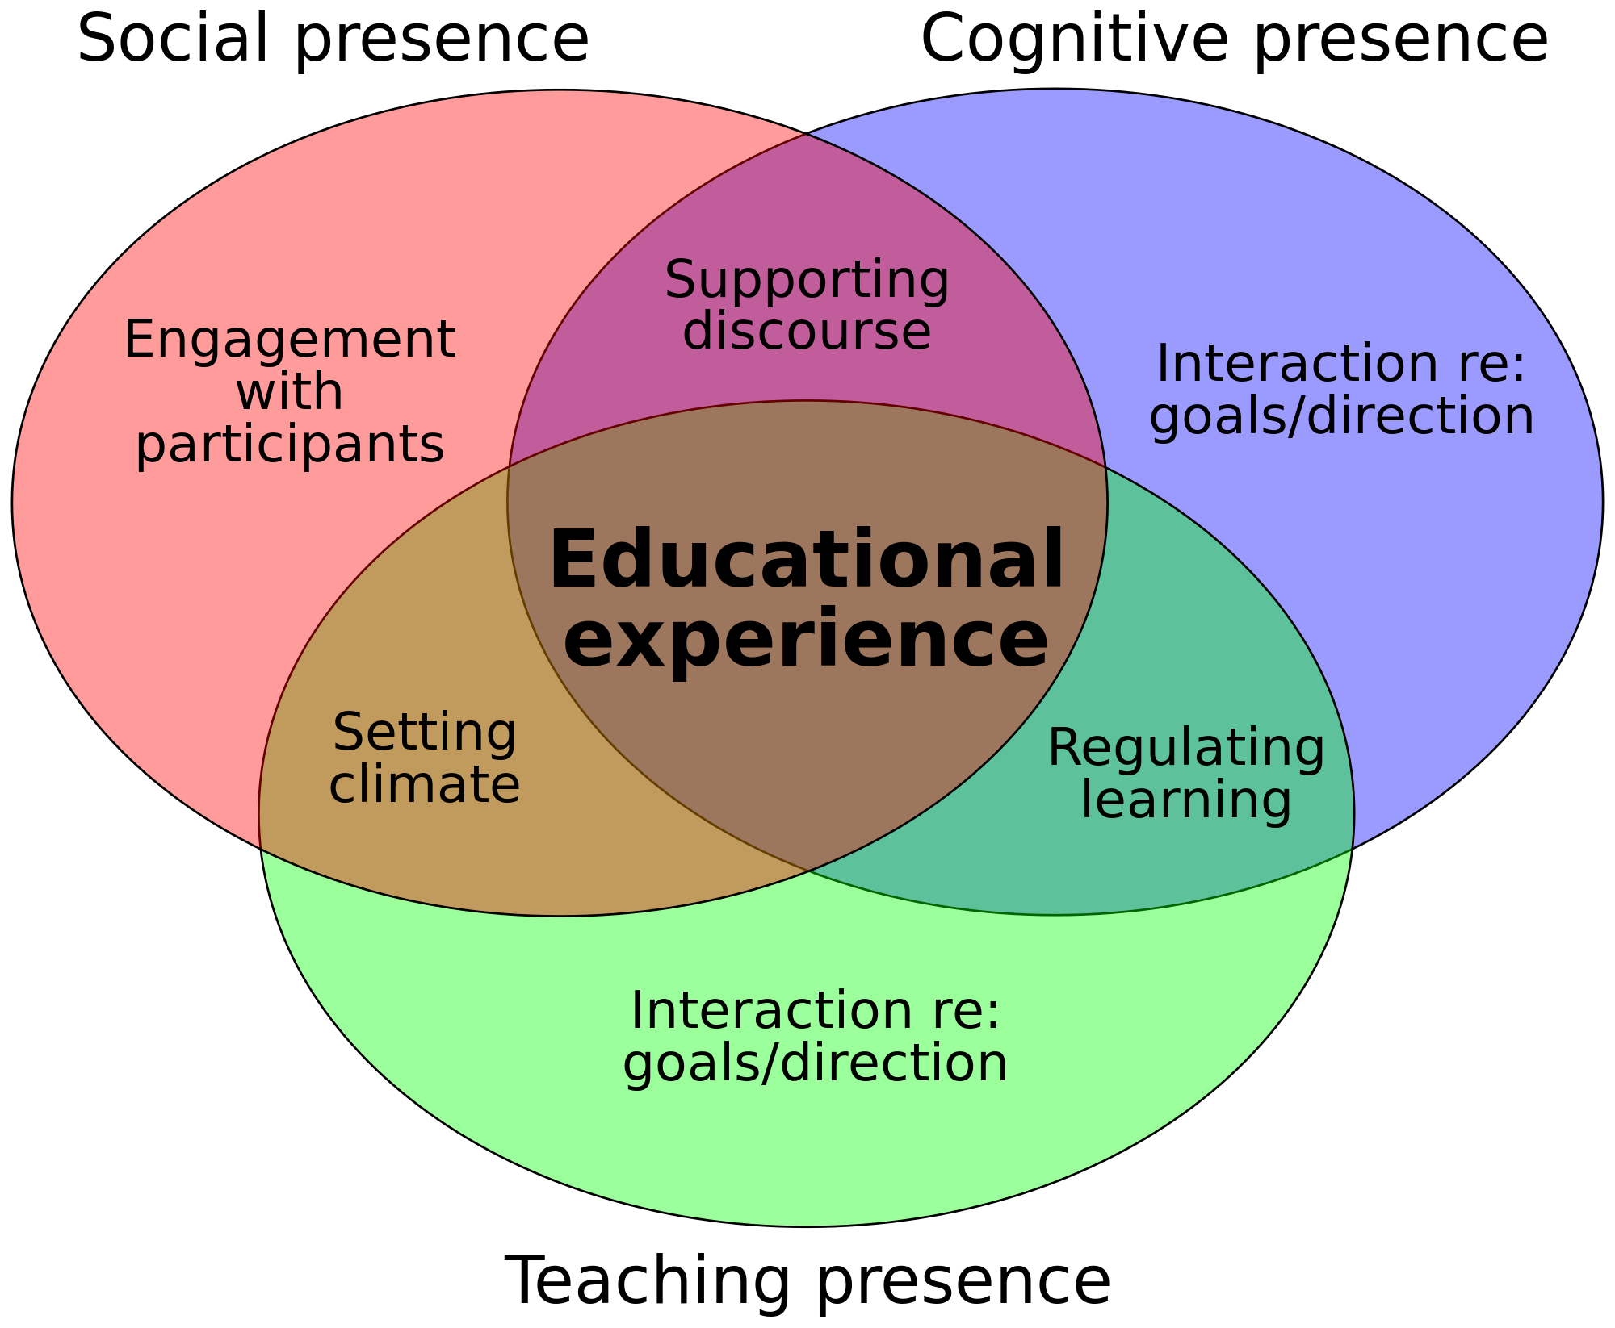

Slide 10
References:
Beldarrain, Y. (2006). Distance Education Trends: Integrating new technologies to foster student interaction and collaboration. Distance Education, 27:2, 139-153.
International Association of Distance Learning (2016, July 9). How to Develop a Distance Learning Curriculum. Retrieved from http://www.iadl.org.uk/Article35.htmMacTeer, C. (2011). Distance Education. n.p.:
Radwan, N. M., Senousy, M. B., & Alaa El Din, M. (2014). Current trends and challenges of developing and evaluating learning management systems.International Journal of e-Education, e-Business, e-Management and e-Learning, 4(5), 361. http://www.ijeeee.org/Papers/351-JZ0078.pdf
Smyth, R. (2011). Emerging technologies in distance education - by george veletsianos. British Journal of Educational Technology, 42(4), E86.

